Slide 1


Gigih Pambuko
10/08/2023

Slide 2

Outline
Executive Summary
Introduction
Methodology
Results
Conclusion
Appendix

Slide 3
Executive Summary
Summary of methodologies
• Data Collection via API, Web Scraping
• Exploratory Data Analysis (EDA) with Data Visualization
• EDA with SQL
• Interactive Map with Folium
• Dashboards with Plotly Dash
• Predictive Analysis
Summary of all results
• Exploratory Data Analysis results
• Interactive maps and dashboard
• Predictive results

Slide 4
Introduction
Project background and context
The aim of this project is to predict if the Falcon 9 first stage will successfully land. SpaceX says on its website that the Falcon 9 rocket launch cost 62 million dollars. Other providers cost upward of 165 million dollars each. The price difference is explained by the fact that SpaceX can reuse the first stage. By determining if the stage will land, we can determine the cost of a launch. This information is interesting for another company if it wants to compete with SpaceX for a rocket launch.
Problems you want to find answers
What are the main characteristics of a successful or failed landing ?
What are the effects of each relationship of the rocket variables on the success or failure of a landing ?
What are the conditions which will allow SpaceX to achieve the best landing success rate ?

Slide 5

Section 1

Slide 6
Methodology
Executive Summary
Data collection methodology:
SpaceX REST API
Web Scrapping from Wikipedia
Perform data wrangling
Dropping unnecessary columns
One Hot Encoding for classification models
Perform exploratory data analysis (EDA) using visualization and SQL
Perform interactive visual analytics using Folium and Plotly Dash
Perform predictive analysis using classification models
How to build, tune, evaluate classification models

Slide 7
Data Collection
Datasets are collected from Rest SpaceX API and webscrapping Wikipedia
The information obtained by the API are rocket, launches, payload information.
The space X REST API URL is https://api.spacexdata.com/v4/rockets/
The information obtained by the webscrapping of Wikipedia are launces, landing, payload information.
URL is https://en.wikipedia.org/wiki/List_of_Falcon_9_and_Falcon_Heavy_launches

Slide 8
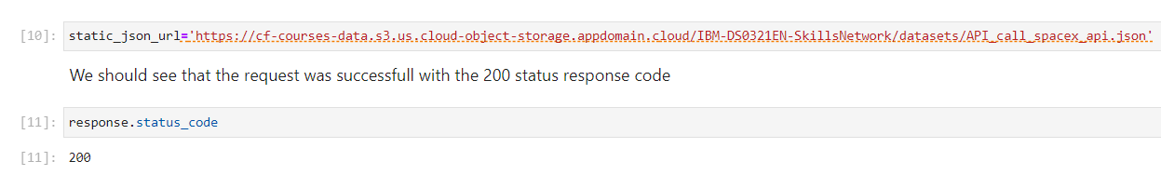
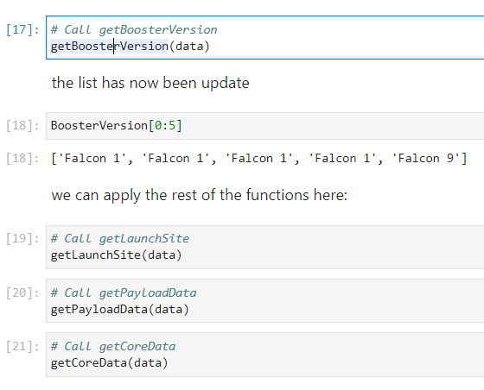
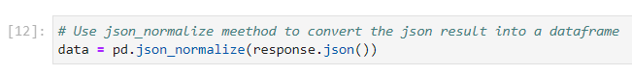
Data Collection – SpaceX API
1. Getting Response from API
3. Transform data
2. Convert Response to JSON File
Link to code

Slide 9
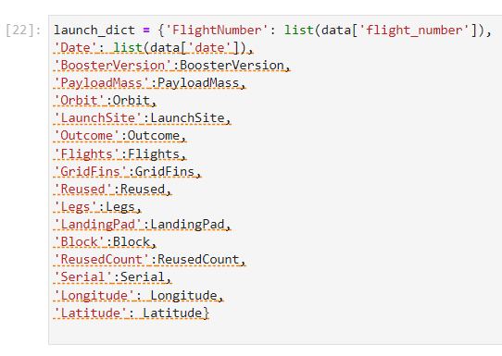
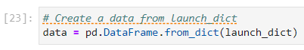
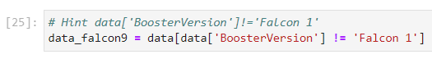
Data Collection – SpaceX API
4. Create dictionary with data
5. Create dataframe
6. Filter dataframe
7. Export to file
Link to code

Slide 10
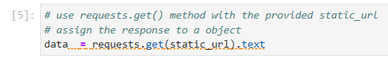
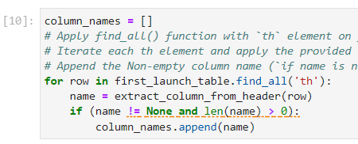
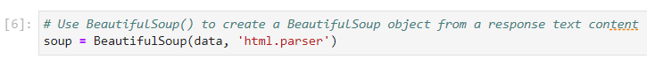
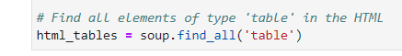
Data Collection - Scraping
1. Getting Response from HTML
4. Get column names
2. Create BeautifulSoup Object
3. Find all tables
Link to code

Slide 11
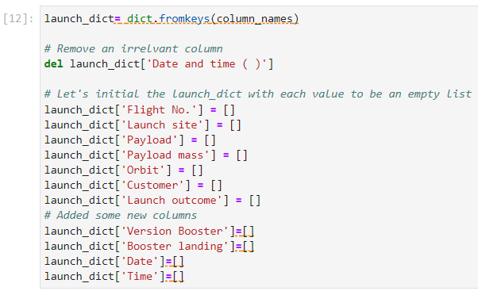
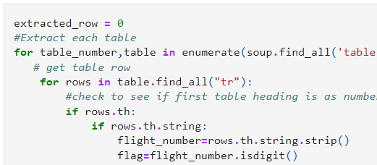
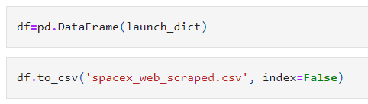
Data Collection - Scraping
5. Create dictionary
6. Add data to keys
7. Create dataframe from dictionary & Export to file
Link to code

Slide 12
Data Wrangling
In the dataset, there are several cases where the booster did not land successully.
True Ocean, True RTLS, True ASDS means the mission has been successful.
False Ocean, False RTLS, False ASDS means the mission was a failure.
We need to transform string variables into categorical variables where 1 means the mission has been successful and 0 means the mission was a failure.
Link to code

Slide 13
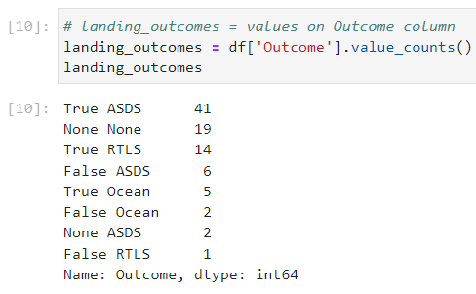
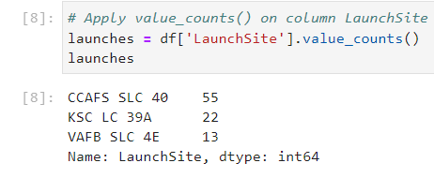
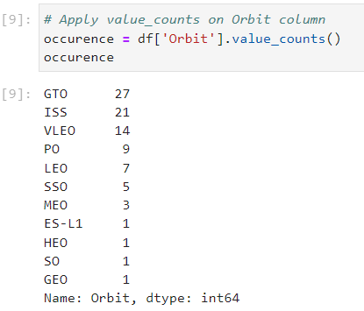
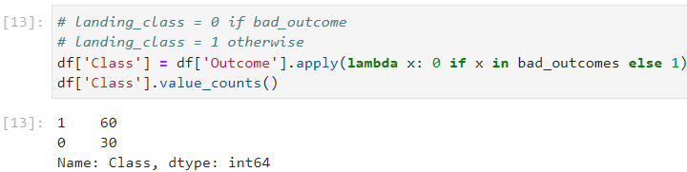
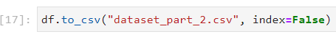
3. Calculate number and occurrence of mission outcome per orbit type
Data Wrangling
1. Calculate launches number for each site
2. Calculate the number and occurrence of each orbit
4. Create landing outcome label from Outcome column
5. Export file
Link to code

Slide 14
EDA with Data Visualization
Scatter Graphs
Flight Number vs. Payload Mass
Flight Number vs. Launch Site
Payload vs. Launch Site
Orbit vs. Flight Number
Payload vs. Orbit Type
Orbit vs. Payload Mass
Scatter plots show relationship between variables.
This relationship is called the correlation.
Bar Graph
Success Rate vs Orbit
Bar graphs show the relationship between numeric and categorical variables.
Line Graph
Success Rate vs Year
Line graphs show data variables and their trends. Line graphs can help to show global behavior and make prediction for unseen data.
Link to code

Slide 15
EDA with SQL
We performed SQL queries to gather and understand data from dataset:
Displaying the names of the unique lauunch sites in the space mission.
Display 5 records where launch sites begin with the string 'CCA'
Display the total payload mass carried by boosters launched by NASA (CRS).
Display average payload mass carried by booster version F9 v1.1.
List the date when the first successful landing outcome in ground pad was achieved.
List the names of the boosters which have success in drone ship and have payload mass greater than 4000 but less than 6000.
List the total number of successful and failure mission outcomes.
List the names of the booster_versions which have carried the maximum payload mass.
List the records which will display the month names, faiilure landing_ouutcomes in drone ship, booster versions, launch_site forthe months in year 2015.
Rank the count of successful landiing_outcomes between the date04-06-2010 and 20-03-2017in descending order.
Link to code

Slide 16
Build an Interactive Map with Folium
Folium map object is a map centered on NASA Johnson Space Center at Houson, Texas
Red circle at NASA Johnson Space Center's coordinate with label showing its name(folium.Circle, folium.map.Marker).
Red circles at each launch site coordinates with label showing launch site name (folium.Circle, folium.map.Marker, folium.features.DivIcon).
The grouping of points in a cluster to display multiple and different information for the same coordinates (folium.plugins.MarkerCluster).
Markers to show successful and unsuccessful landings. Green for successful landing and Red for unsuccessful landing. (folium.map.Marker, folium.Icon).
Markers to show distance between launch site to key locations (railway, highway, coastway, city) and plot a line between them. (folium.map.Marker, folium.PolyLine, folium.features.DivIcon)
These objects are created in order to understand better the problem and the data. We can show easily all launch sites, their surroundings and the number of successful and unsuccessful landings.
Link to code

Slide 17
Build a Dashboard with Plotly Dash
Dashboard has dropdown,pie chart,rangeslider andscatter plot components
Dropdownallows a user to choose the launch site or all launch sites (dash_core_components.Dropdown).
Pie chart shows the total success and the total failure for the launch site chosen with the dropdown component(plotly.express.pie).
Rangeslider allows a user to select a payload mass in a fixed range (dash_core_components.RangeSlider).
Scatter chart showsthe relationship between two variables, in particular Success vs Payload Mass (plotly.express.scatter).
Link to code

Slide 18
Predictive Analysis (Classification)
Data Preparation
Load dataset
Normalize data
Split data into training and test sets.
Model Preparation
Selection of machine learning algorithms
Set parameters for each algorithm to GridSearchCV
Training GridSearchModel models with training dataset
Model Evaluation
Get best hyperparameters for each type of model
Compute accuracy for each model with test dataset
Plot Confusion Matrix
Model Comparison
Comparison of models according to their accuracy
The model with the best accuracy will be chosen (see Notebook for result)
Link to code

Slide 19
Results
Exploratory data analysis results
Interactive analytics demo in screenshots
Predictive analysis results

Slide 20

Section 2

Slide 21
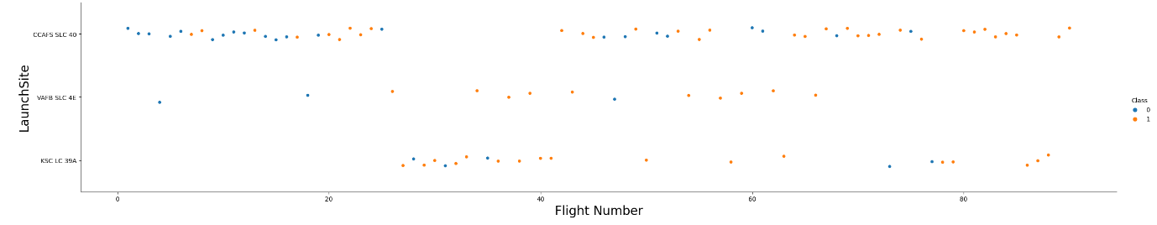
Flight Number vs. Launch Site
We observe that, for each site, the success rate is increasing.

Slide 22
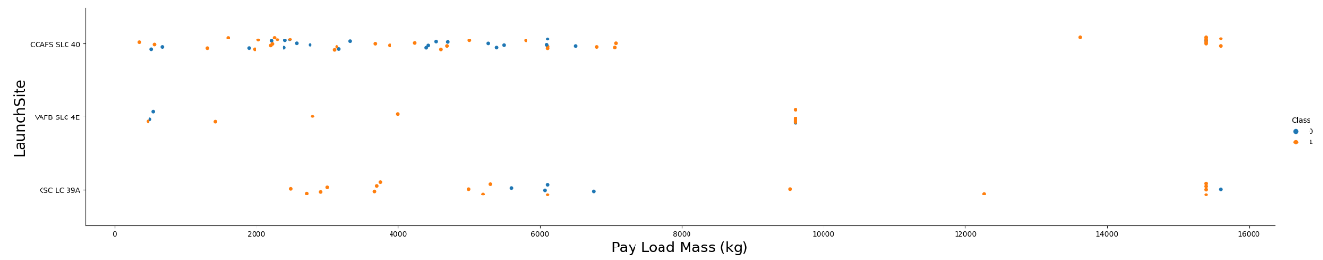
Payload vs. Launch Site
Depending on the launch site, a heavier payload may be a consideration for a successful landing. On the other hand, a too heavy payload can make a landing fail.

Slide 23
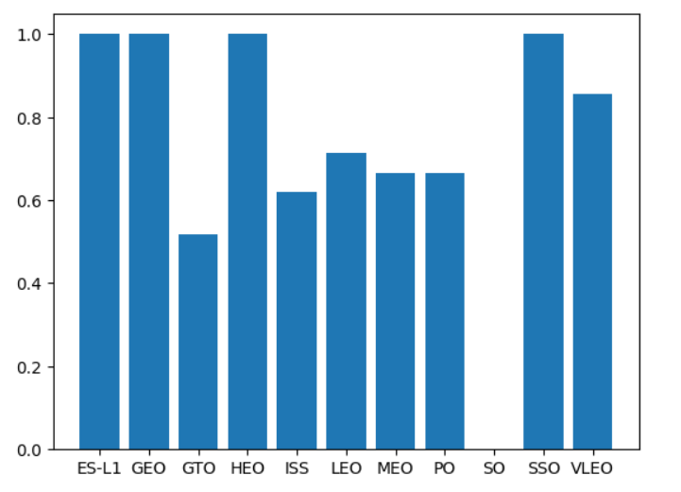
Success Rate vs. Orbit Type
With this plot, we can see success rate for different orbit types. We note that ES-L1, GEO, HEO, SSO have the best success rate.

Slide 24
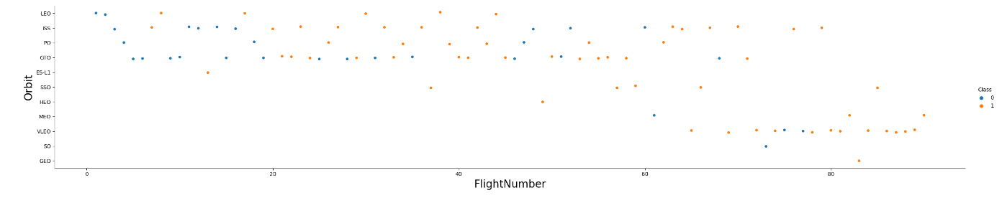
Flight Number vs. Orbit Type
We notice that the success rate increases with the number of flights for the LEO orbit. For some orbits like GTO, there is no relation between the success rate and the number of flights. But we can suppose that the high success rate of some orbits like SSO or HEO is due to the knowledge learned during former launches for other orbits.

Slide 25
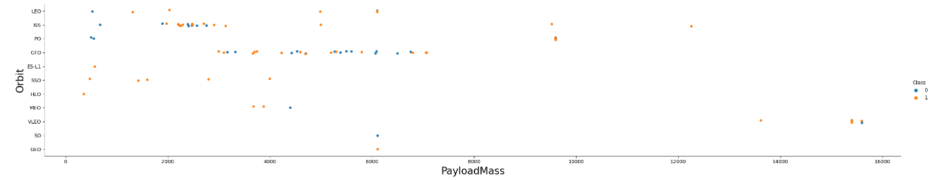
Payload vs. Orbit Type
The weight of the payloads can have a great influence on the success rate of the launches in certain orbits. For example, heavier payloads improve the success rate for the LEO orbit.Another finding is that decreasing the payload weight for a GTO orbit improves the success of a launch.

Slide 26
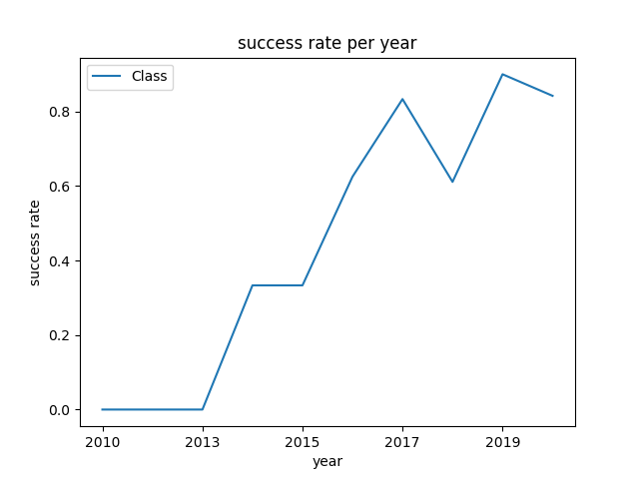
Launch Success Yearly Trend
Since 2013, we can see an increase in the Space X Rocket success rate.

Slide 27
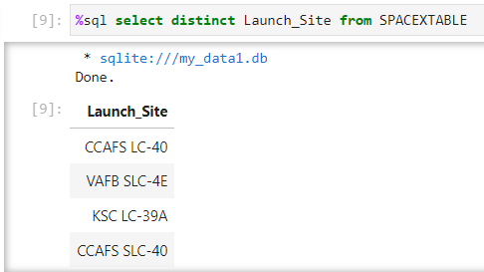
All Launch Site Names
Query
Result
Explanation: The use of DISTINCT in the query allows to remove duplicate LAUNCH_SITE.

Slide 28
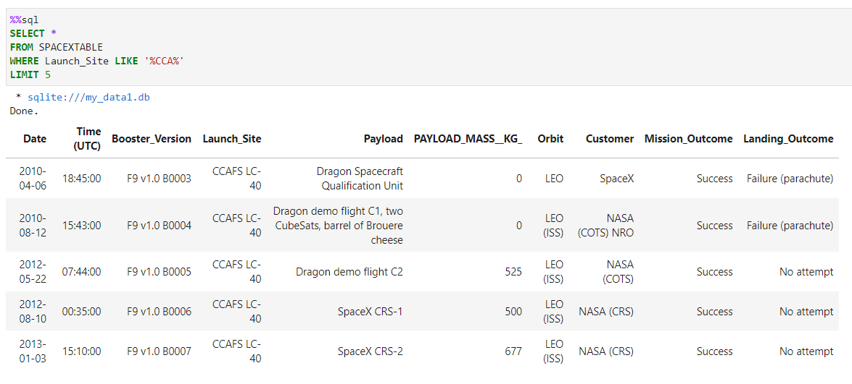
Launch Site Names Begin with 'CCA'
Query
Result
Explanation:
The WHERE clause followed by LIKE clause filters launch sitesthat contain the substring CCA.
LIMIT 5 shows 5 records from filtering.

Slide 29
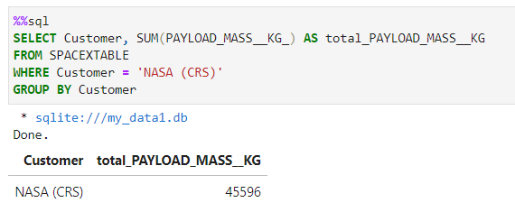
Total Payload Mass
Query
Result
Explanation:
This query returns the sum of all payload masses where the customer is NASA (CRS).

Slide 30
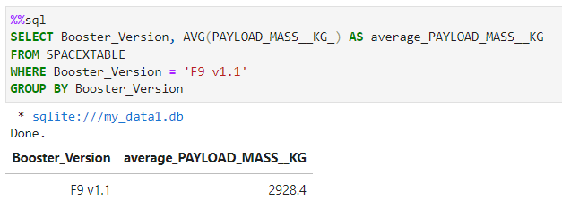
Average Payload Mass by F9 v1.1
Query
Result
Explanation:
This query returns the average of all payload masses where the booster version contains the substring F9 v1.1.

Slide 31
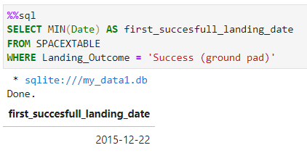
First Successful Ground Landing Date
Query
Result
Explanation:
With this query, we select the oldest successful landing.
The WHERE clause filters dataset in order to keep only records where landing was successful. With the MIN function, we select the record with the oldest date.

Slide 32
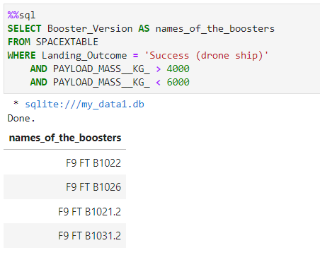
Successful Drone Ship Landing with Payload between 4000 and 6000
Query
Result
Explanation:
This query returns the booster version where landing was successful and payload mass is between 4000 and 6000 kg. The WHERE and AND clauses filter the dataset.

Slide 33
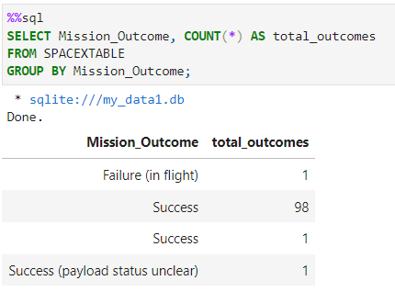
Total Number of Successful and Failure Mission Outcomes
Query
Result
Explanation:
With the first SELECT, we show the queries counts total mission outcome. The group by classifies data record from mission outcome column.

Slide 34
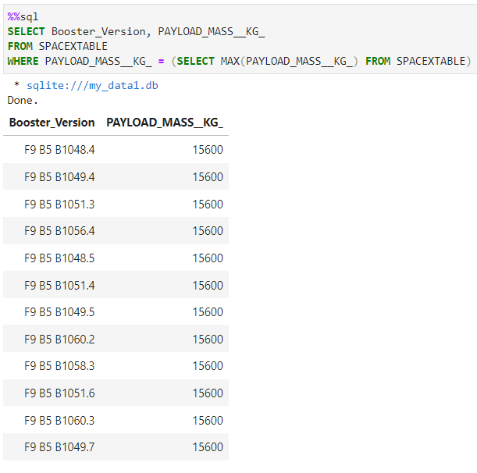
Boosters Carried Maximum Payload
Query
Explanation:
We used a subquery to filter data by returning only the heaviest payload mass with MAX function. The main query uses subquery results and returns unique booster version (SELECT DISTINCT) with the heaviest payload mass.
Result

Slide 35
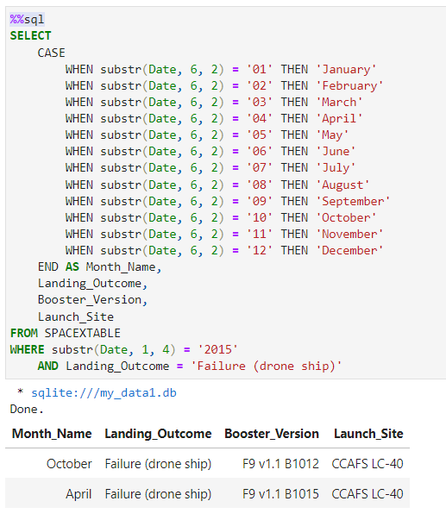
2015 Launch Records
Query
Explanation:
This query returns month, booster version, launch site where landing was unsuccessful and landing date took place in 2015. Substr function process date in order to take month or year. Substr(DATE,1, 4) shows year.
Result

Slide 36
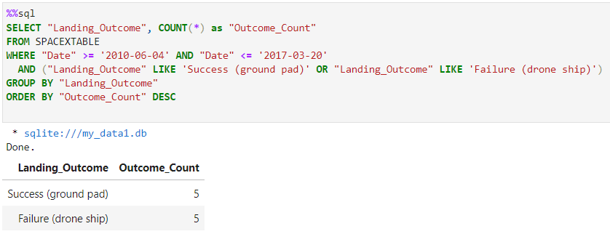
Rank Landing Outcomes Between 2010-06-04 and 2017-03-20
Query
Result
Explanation:
It focuses on missions that happened between June 4, 2010, and March 20, 2017. It counts how many times each outcome is labeled as either "Success (ground pad)" or "Failure (drone ship)". The code then shows these counts, arranging them from the most common outcome to the least common one.

Slide 37

Section 3

Slide 38
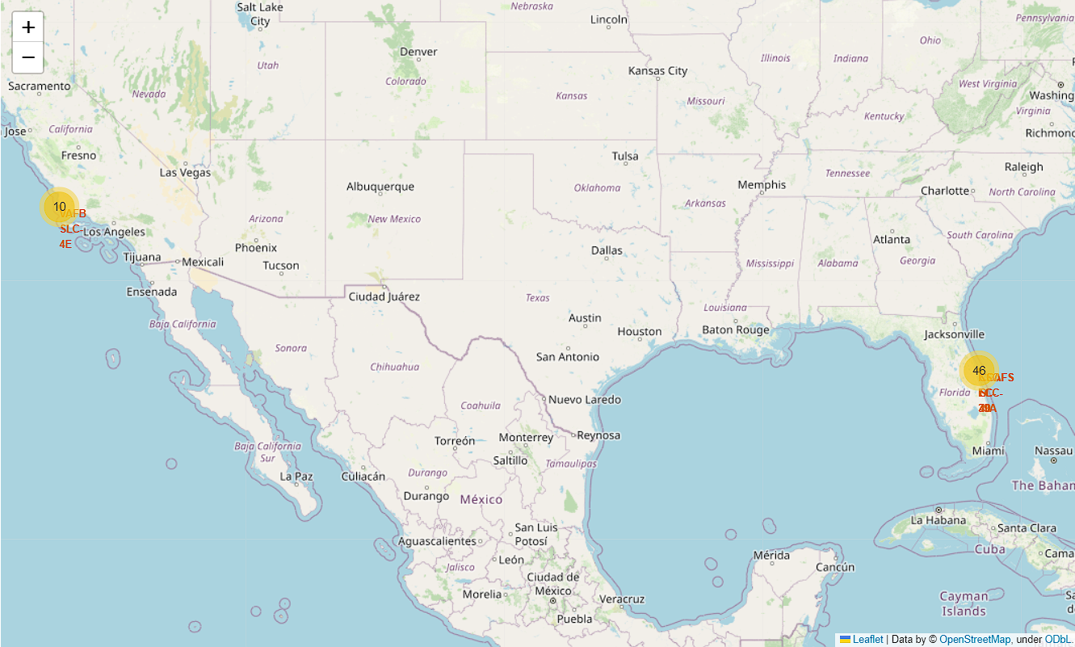
Folium map – Ground Station
We see that Space X launch sites are located on the coast of the United States

Slide 39
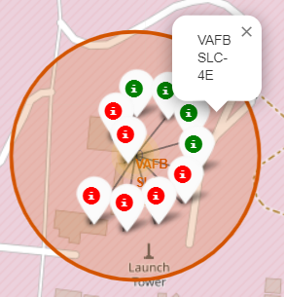
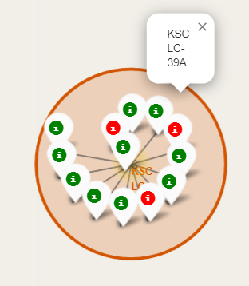
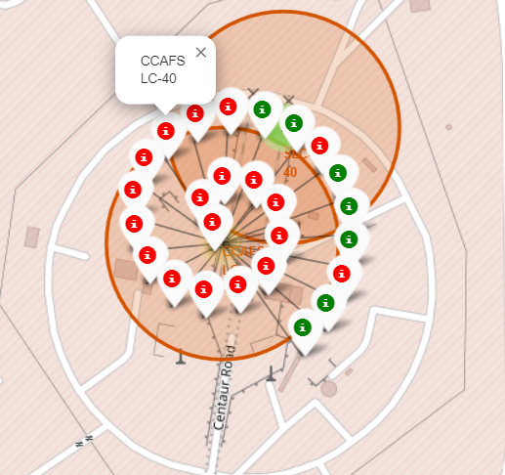
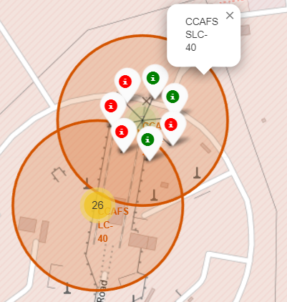
Folium map – Color Labeled Markers
Green marker represents successful launches. Red marker represents unsuccessful launches. We note that KSC LC-39A has a higher launch success rate.

Slide 40
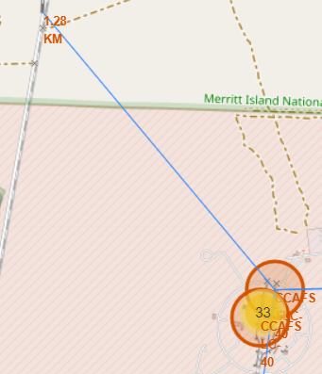
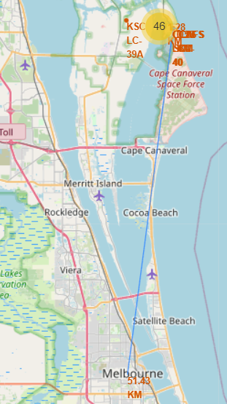
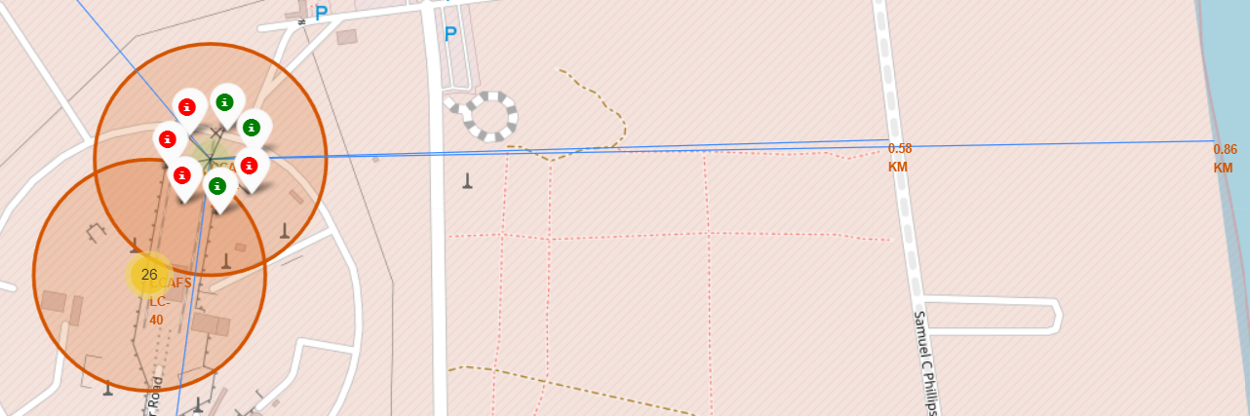
Folium map – Distance between CCAFS SLC-40 and its proximities
Is CCAFS SLC-40 in close proximity to railways ? Yes
Is CCAFS SLC-40 in close proximity to highways ? Yes
Is CCAFS SLC-40 in close proximity to coastline ? Yes
DoCCAFS SLC-40 keeps certain distance away from cities ? No

Slide 41

Section 4

Slide 42
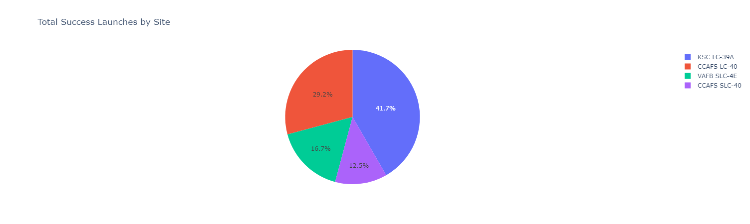
Dashboard – Total success by Site
We see that KSC LC-39A has the best success rate of launches.

Slide 43
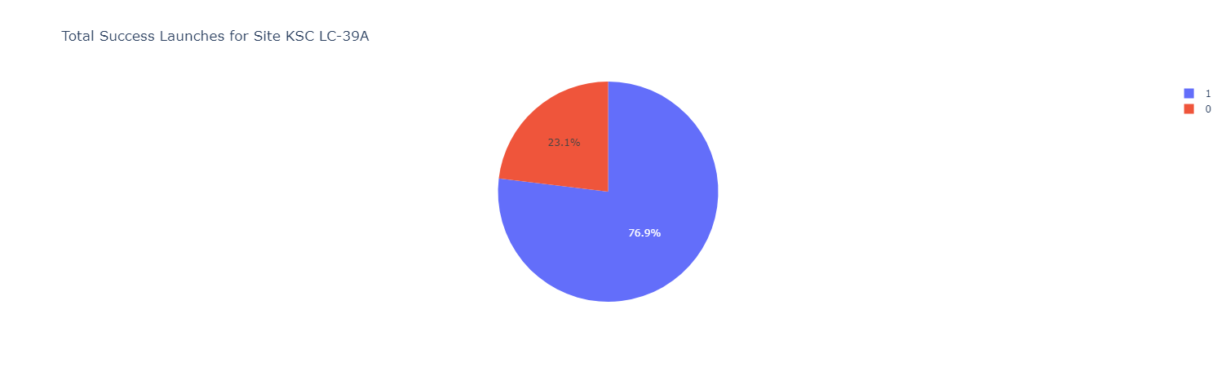
Dashboard – Total success launches for Site KSC LC-39 A
We see that KSC LC-39A has achieved a 76.9% success ratewhile getting a 23.1% failure rate.

Slide 44
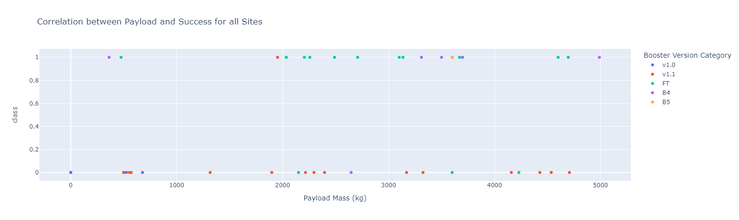
Dashboard –Payload mass vs Outcome for all sites with different payload mass selected
Low weighted payloads have a better success rate than the heavy weighted payloads.

Slide 45

Section 5

Slide 46
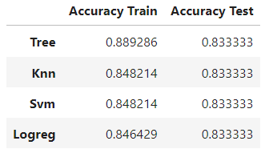
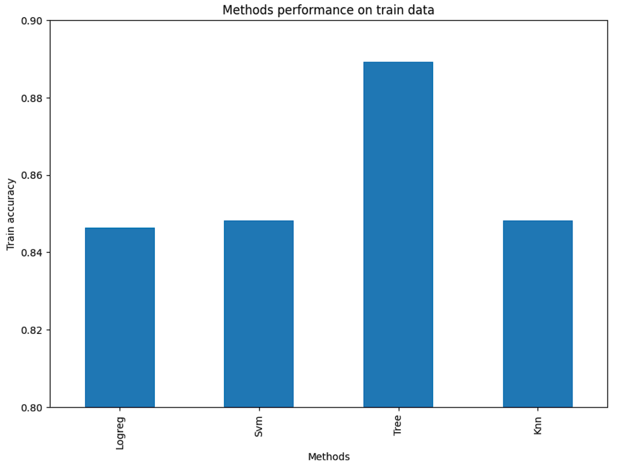
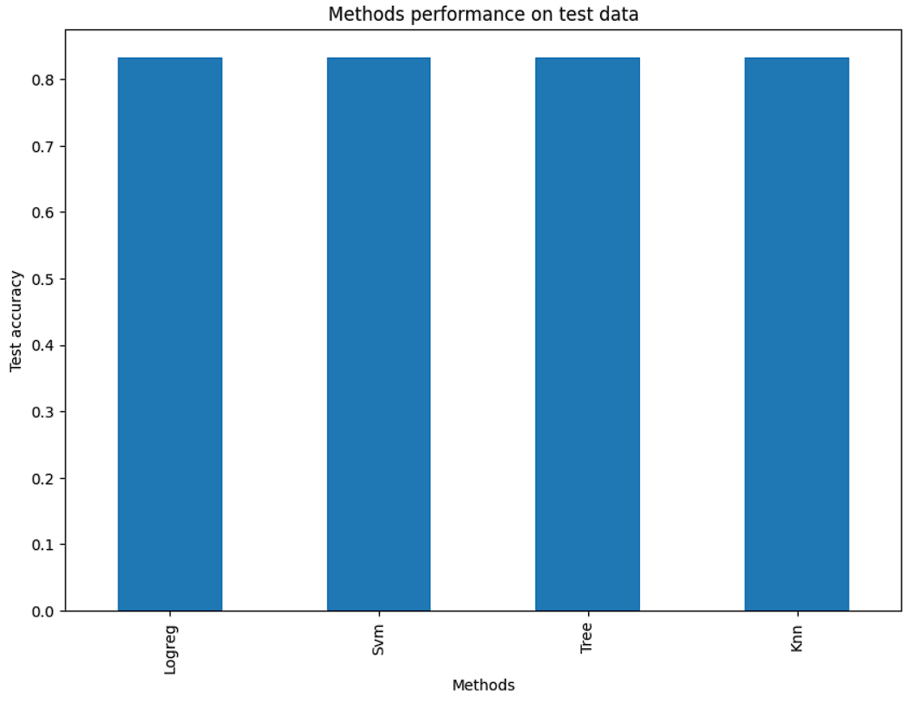
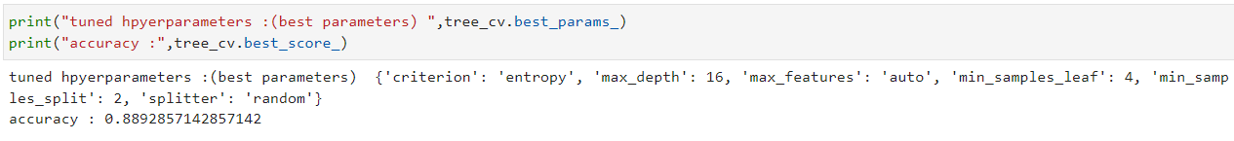
Classification Accuracy
For accuracy test, all methods performed similar. We could get more test data to decide between them.But if we really need to choose one right now, we would take the decision tree.

Slide 47
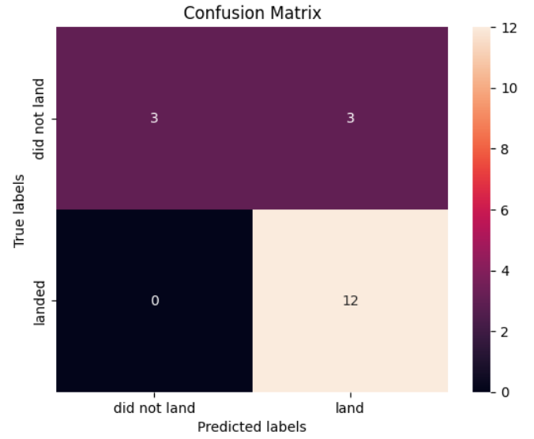



Confusion Matrix
Logistic regression
SVM
Decision Tree
KNN
As the test accuracy are all equal, the confusion matrices are also identical. The main problem of these models are false positives.

Slide 48
Conclusions
The success of a mission can be explained by several factors such as the launch site, the orbit and especially the number of previous launches. Indeed, we can assume that there has been a gain in knowledge between launches that allowed to go from a launch failure to a success.
The orbits with the best success rates are GEO, HEO, SSO, ES-L1.
Depending on the orbits, the payload mass can be a criterion to take into account for the success of a mission. Some orbits require a light or heavy payload mass. But generally low weighted payloads perform better than the heavy weighted payloads.
With the current data, we cannot explain why some launch sites are better than others (KSC LC-39A is the best launch site). To get an answer to this problem, we could obtain atmospheric or other relevant data.
For this dataset, we choose the Decision Tree Algorithm as the best model even if the test accuracy between all the models used is identical. We choose Decision Tree Algorithm because it has a better train accuracy.

Slide 49


